Slide 1

The Effect of Minimum Wage on Employment
The Terrific Team That tejas trained
Devin, Kosel, Lesly, Mark, Will

Slide 2
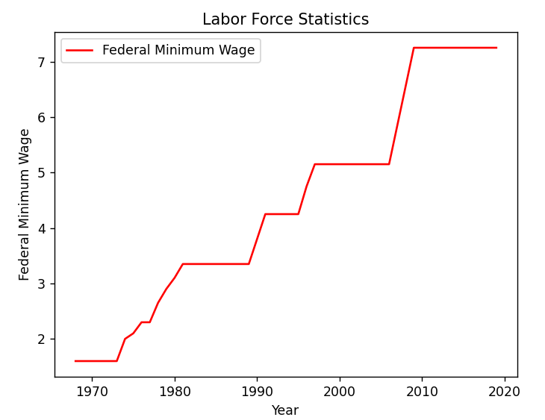
Minimum Wage in America
Minimum wage was established in 1938 under the Fair Labor Standard Act, which established a federal minimum wage of 25 cents per hour. The bill was signed into law by President Roosevelt as part of the New Deal to protect workers during the Great Depression.
The purpose of the minimum wage is to provide a base pay rate for employees and protect workers against unduly low pay.
The U.S. current national minimum wage is $7.25 per hour. Many states and cities have their own minimum wage. Employees receive whichever is higher, the federal or local minimum wage.

Slide 3
Arguments for the Minimum Wage
The impact of raising the minimum wage is one of the most debated subjects in economics
Many businesses and conservatives oppose raising the minimum wage arguing a higher minimum wage generally leads employers to reduce the size of their work force. While progressive economists have challenged these assumptions.

Slide 4
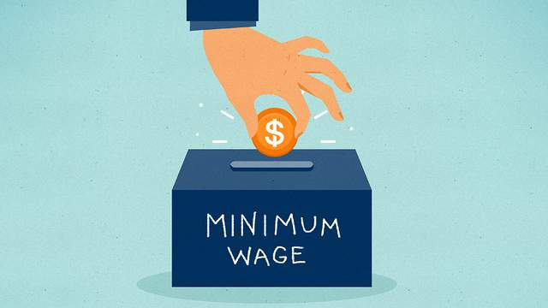
Does increasing minimum wage influence employment opportunities?

Slide 5
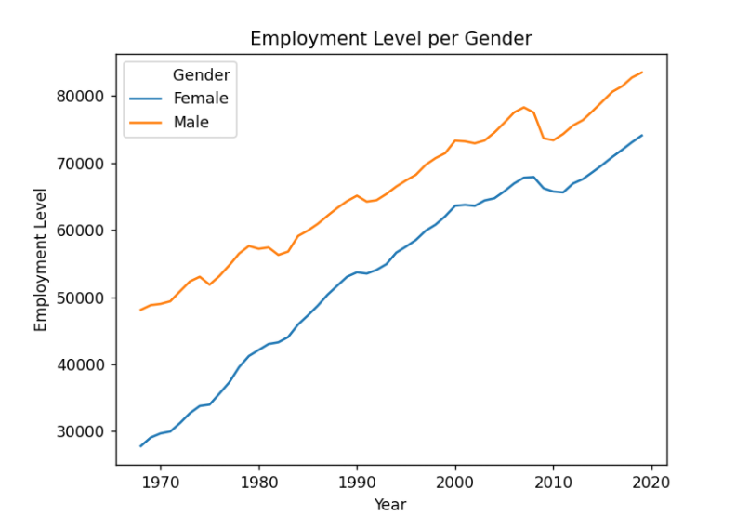
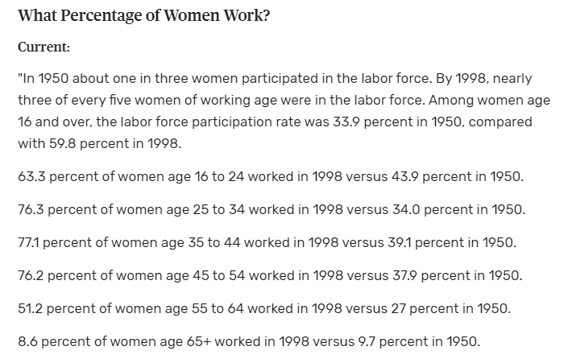
Rising female labor force participation has been one of the most remarkable economic developments of the last century.

Slide 6
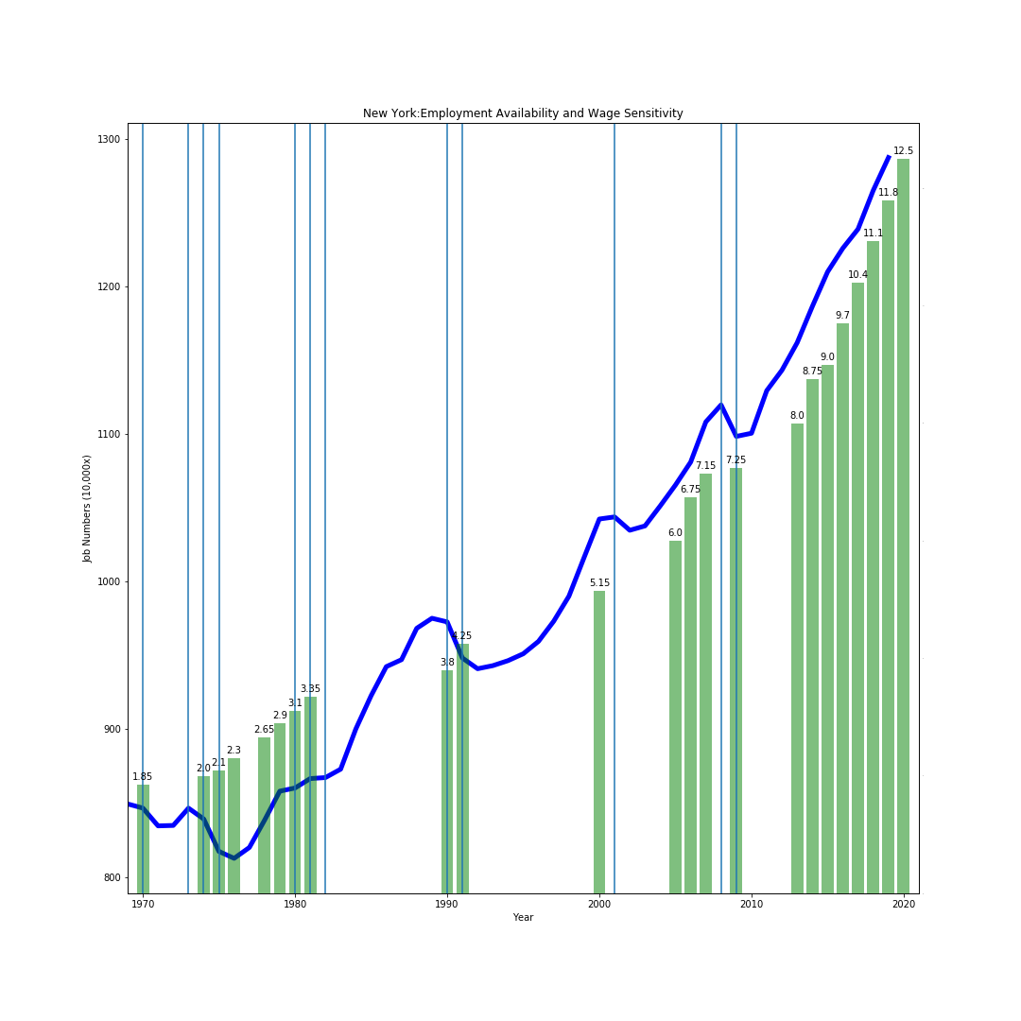
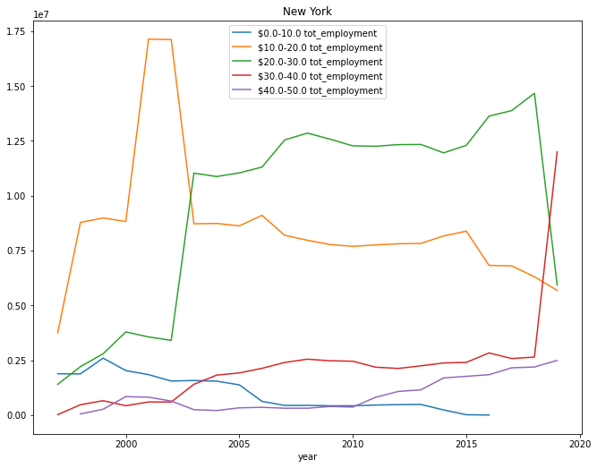

Slide 7
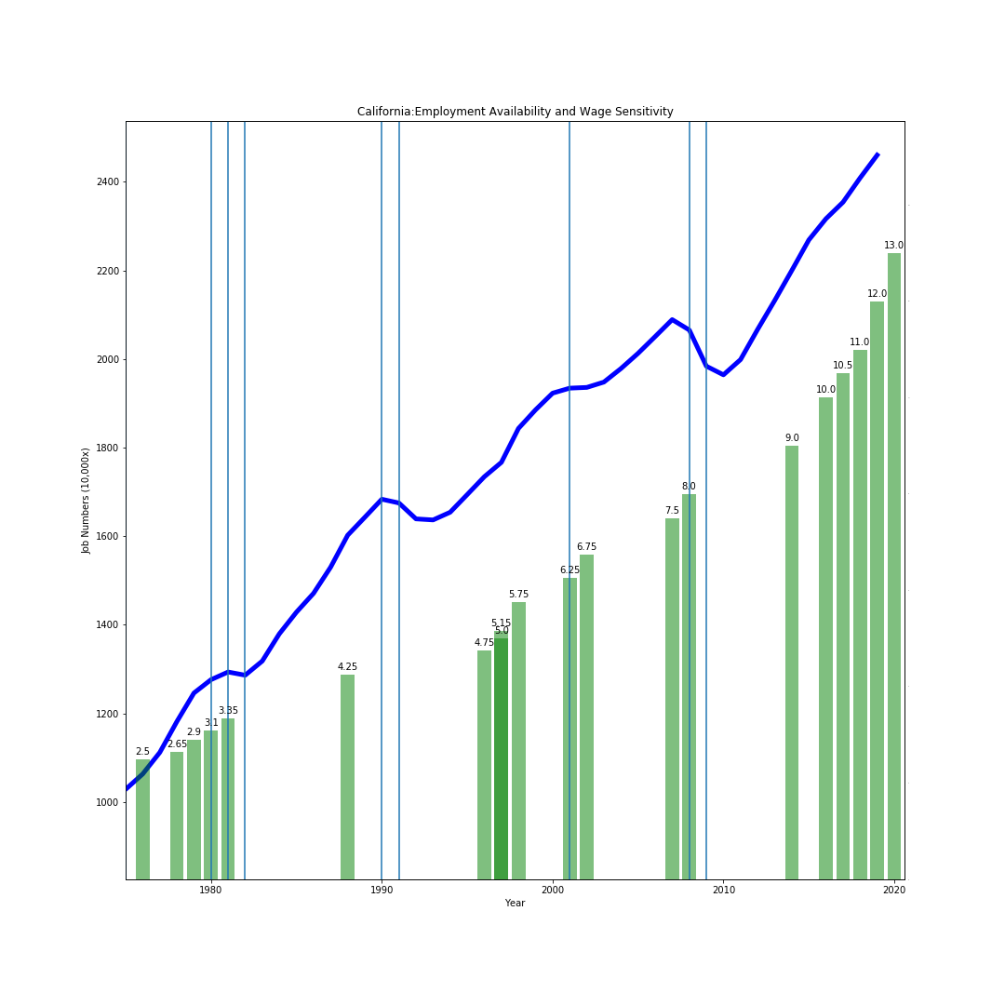
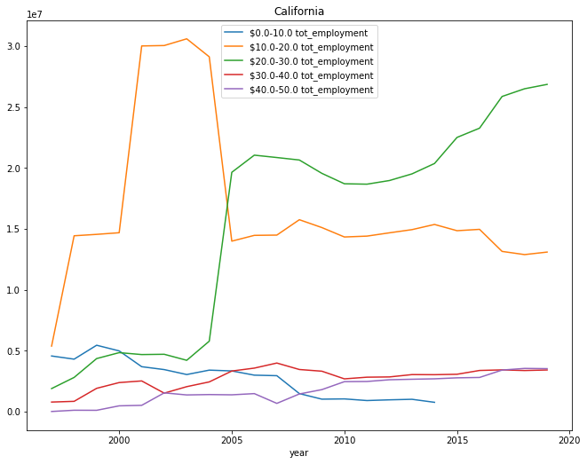

Slide 8
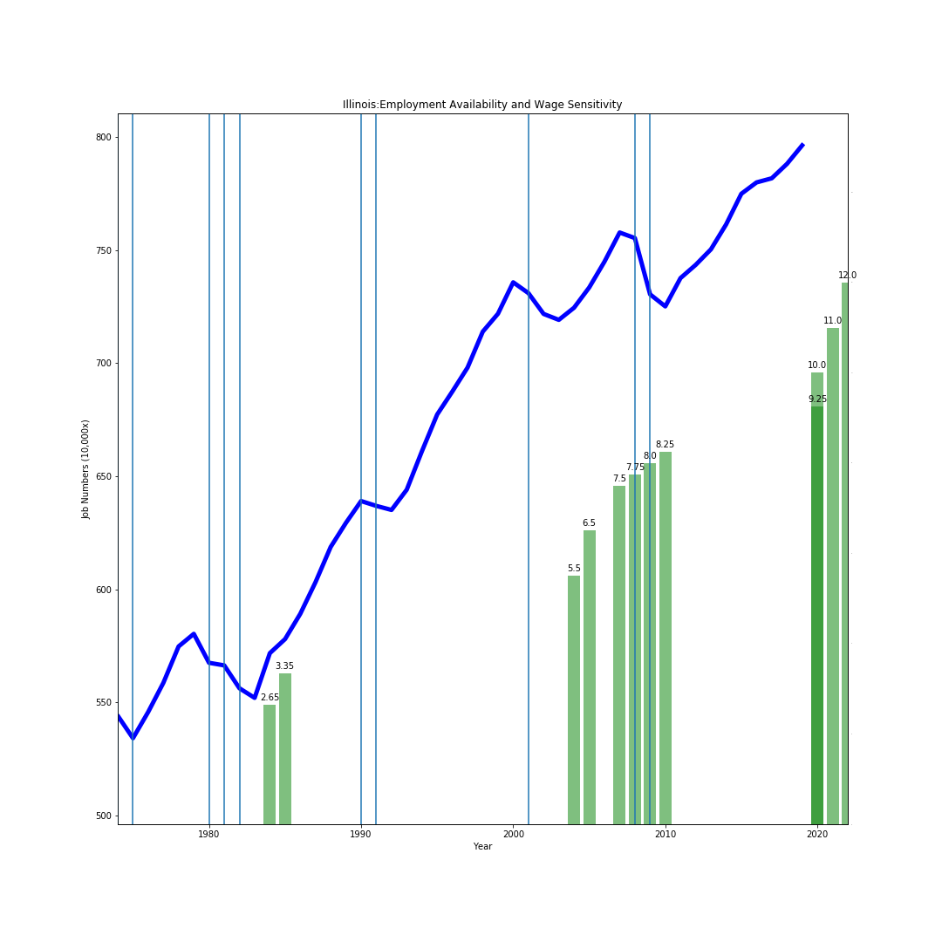
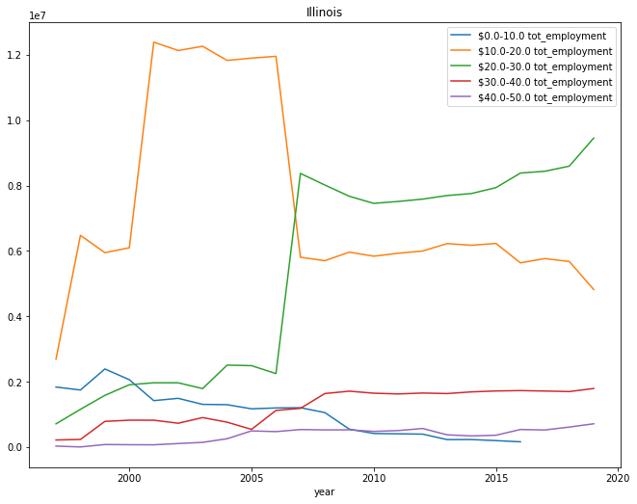

Slide 9
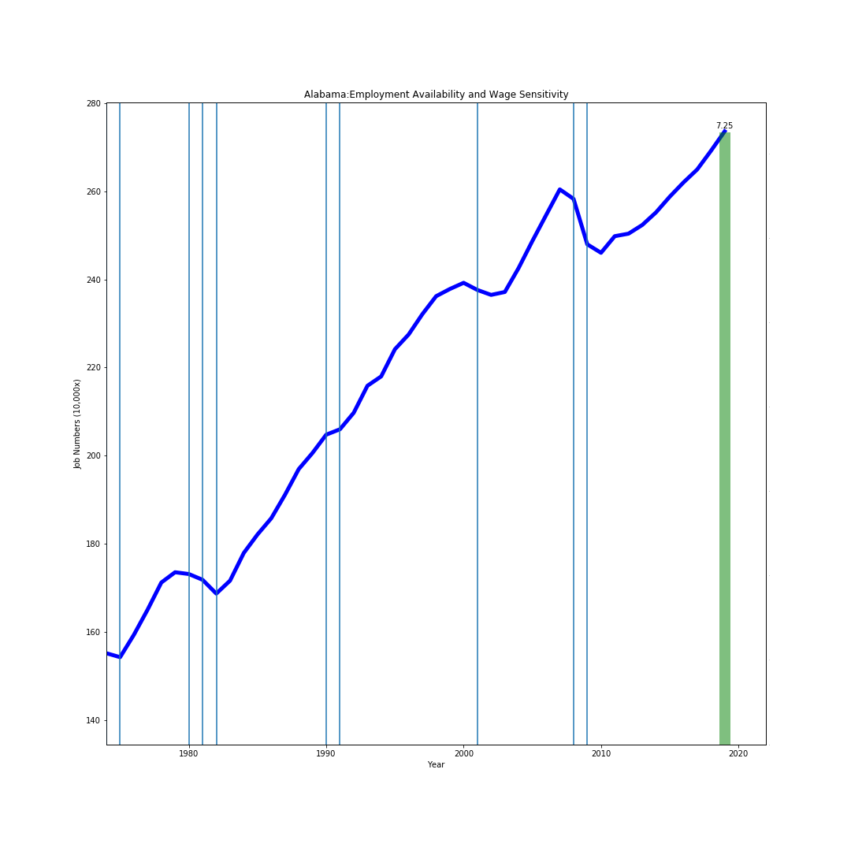
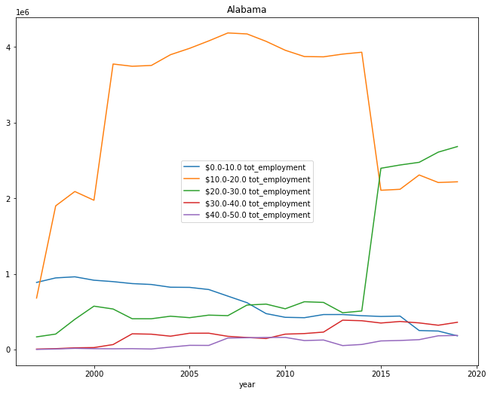

Slide 10
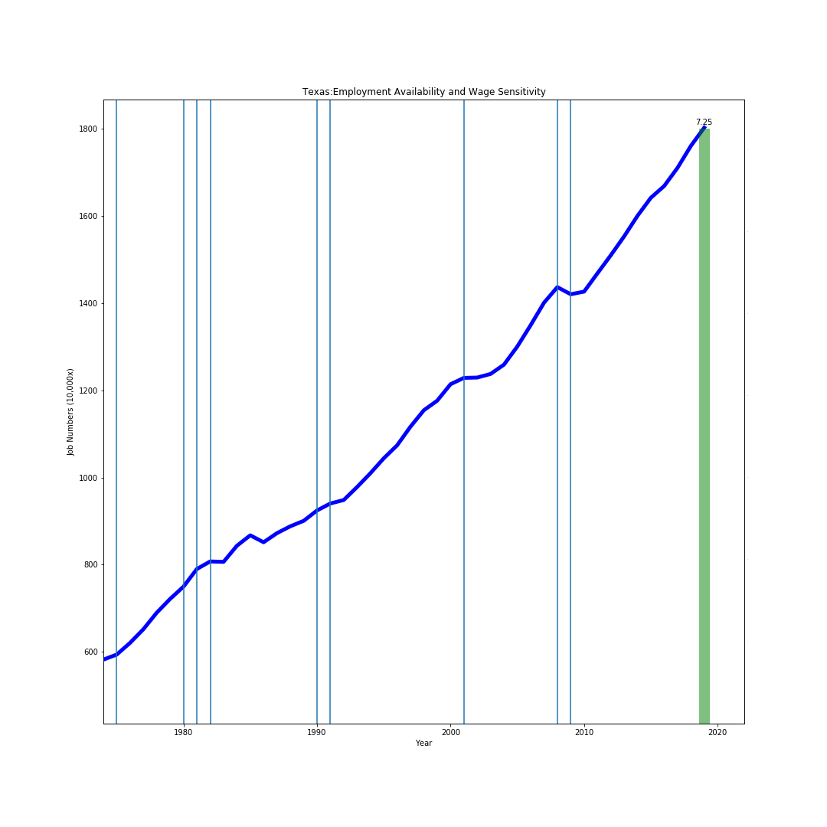
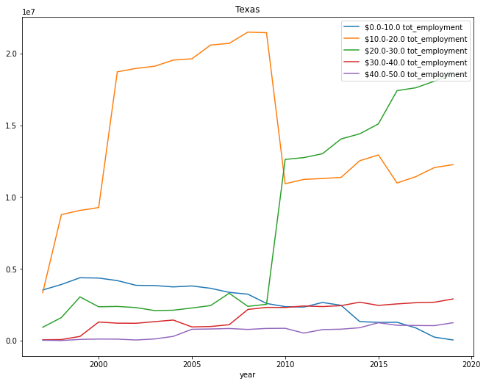

Slide 11

Questions
Questions

